Slide 1
Hyperledger
Indy Agents
Kyle Den Hartog, Evernym
Hyperledger Indy Ambassador

Slide 2
Link to Slides
bitly.com/indy-dev

Slide 3

Kyle Den Hartog
Software Engineer, Evernym
Indy core developer
Twitter: @kyle_dh
Hyperledger Chat: kdenhartog

Slide 4


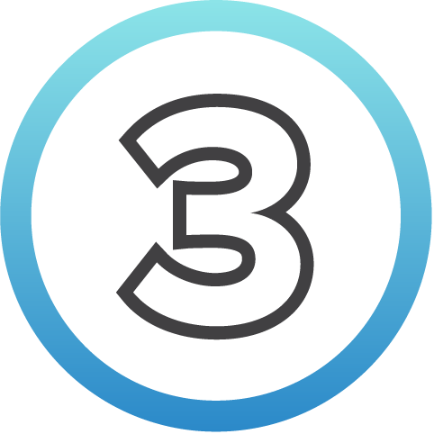

Agenda
Decentralized Identity Concepts
Hyperledger
Indy Architecture
Demo Use Case
Hyperledger Indy and How to Get Involved

Slide 5
Identity Models

Slide 6


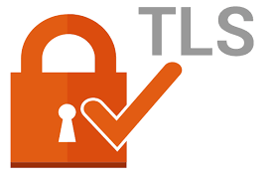
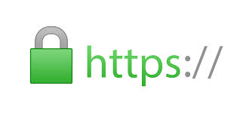
Centralized Identity
Org
You
Account
Standards:
CC BY-SA 4.0 - From The Story of SSI Open Standards by Drummond Reed, Chief Trust Officer Evernym and Sovrin Foundation Trustee
Notes:
You create a digital credential to access a single organization's service. This single centralized authority owns the data that you provide. This single authority can deny you access to your data or can accept a fraudulent identity. Power exists with these centralized authorities. This is how the majority of the Internet operates today. You end up with hundreds of different credentials across different organizations whose services you would like to utilize.

Slide 7


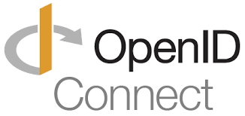
Third Party IDP (Federated Identity)
IDP
Org
You
Account
Standards:
CC BY-SA 4.0 - From The Story of SSI Open Standards by Drummond Reed, Chief Trust Officer Evernym and Sovrin Foundation Trustee
Notes:
With the Federated Identity models, users could now use a single identity provider to access multiple sites. This reduces the number of credentials that we have to remember. The challenge is that now we have many powerful entities that control access to the services of other sites. Social networks, including Facebook, Google, and Twitter, are probably the best known entities providing federated identity. In this model, we are ceding control and liability to a third party. In some cases, the only option is to sign up for a third party account so that we can gain access to a particular service. The IDP now has access to information about our service usage.

Slide 8
Self Sovereign Identity (SSI)
You
Peer
Connection
Distributed Ledger (Blockchain)
CC BY-SA 4.0 - From The Story of SSI Open Standards by Drummond Reed, Chief Trust Officer Evernym and Sovrin Foundation Trustee
Notes:
Entities should be the rulers of their identities. Self-Sovereign Identity is a lifetime, portable digital identity for any person, organization, or thing that does not depend on any centralized authority and can never be taken away. In other words, we own the identity. With Self-Sovereign Identity, no one can "turn the lights out" or take the credential away from you without your consent. They can revoke the credential, but you still have access to that credential.

Slide 9
Decentralized Identifiers

Slide 10
URN Syntax (RFC 2141)
urn:uuid:ae84-d5c2-9fb785ea-72cd34
Namespace-specific Identifier
Namespace
Scheme
Notes:
DIDs take their format from the URN Syntax.

Slide 11
DID Syntax
did:sov:3k9dg356wdcj5gf2k9bw8kfg7a
Method-specific Identifier
Method
Scheme
Notes:
From Decentralized Identifiers v0.11, "A DID is similar to a UUID except: (a) like a URL, it can be resolved or dereferenced to a standard resource describing the entity (a DID Document—see Section 4. DID Documents ), and (b) unlike a URL, the DID Document typically contains cryptographic material that enables authentication of an entity associated with the DID."

Slide 12
You will not just have one DID
Individuals will have hundreds or thousands of DIDs to control correlation based on their needs
--
each one is a contextually-unique pseudonym
Notes:
For every relationship I need to develop, I will have a unique DID. You will manage your personal collection of DIDs with a software agent (similar to your contact list today).

Slide 13
Verifiable Credentials

Slide 14




Today's Credential Workflow
Issuer
Person
Verifier
Credential
2. Present credential
1. Issue credential
3. Validate credential integrity
Notes:
In today's world, we are issued credentials as documents (like our driver's license). When we need to prove who we are, we hand over the document. The verifier will look at the document and attempt to ascertain whether it is valid. In addition, we cannot choose to only hand over a certain piece of the document, we must hand the entire document over.

Slide 15
Verifiable Credential Workflow
Issuer
Person
Verifier
Credential
3. Present credential
2. Issue credential
1. Register proof of credential integrity and provenance
4. Validate credential integrity and provenance
Blockchain Registry
CC BY-NC-SA 4.0 - Adapted from Blockchain Security and Privacy by Anil John, Digital Security Coach
Notes:
From Verifiable Credentials Model 1.0
holder
A role an entity may perform by possessing one or more verifiable credentials. Examples of holders include students, employees, and customers.
issuer
A role an entity may perform by creating a verifiable credential, associating it with a particular subject, and transmitting it to a holder. Examples of issuers include corporations, non-profits, trade associations, governments, and individuals.
verifier
A role an entity may perform by receiving one or more verifiable credentials for processing. Examples of verifiers include employers, security personnel, and websites.
identifier registry
A role a system may perform by mediating the creation and verification of subject identifiers. Examples of identifier registries include corporate employee databases, government ID databases, and distributed ledgers.

Slide 16

A zero-knowledge protocol is a method by which one party (the prover) can prove to another party (the verifier) that something is true, without revealing any information apart from the fact that this specific statement is true.
- The Knowledge Complexity of Interactive Proof Systems
Shafi Goldwasser, Silvio Micali and Charles Rackoff
Notes:
The notion of zero-knowledge was first proposed in 1985 by MIT researchers. From Lukas Schor's medium post : zero-knowledge proofs let you validate the truth of something without revealing how you know that truth or sharing the content of this truth with the verifier. This principle is based on an algorithm that takes some data as input and returns either ‘true’ or ‘false’.

Slide 17

Proving Your Age
Name: John Doe
Address:
123 Never St
Phoenix, AZ 85001
Birth Date: 01/01/1995
Over 21
Without
Zero Knowledge Proofs
With
Zero Knowledge Proofs

Slide 18
20?
Every individual question in the game 20 questions is an example of how a zero knowledge proof request works. Similar to the game, if the guesser asks good questions, they'll be able correlate too much information.

Slide 19
Decentralized Key Management

Slide 20


Agents mapped to the real world

Slide 21
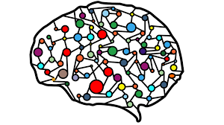
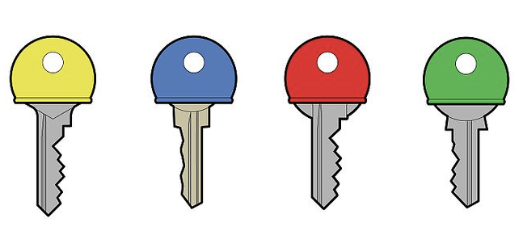
Agents make key management organized
Notes:
With DIDs for every connection and a different key for every device there's a lot of keys to manage
Agents abstract keys away from users and partially from developers while keeping the "key" advantages
Agent's act on your behalf to manage keys,

Slide 22
Agents allow for diffused trust of keys
Notes:
With DIDs for every connection and a different key for every device there's a lot of keys to manage
Agents abstract keys away from users and partially from developers while keeping the "key" advantages
Agent's act on your behalf to manage keys,

Slide 23




Social Recovery

Slide 24
Three Planes of Self Sovereign Identity

Slide 25

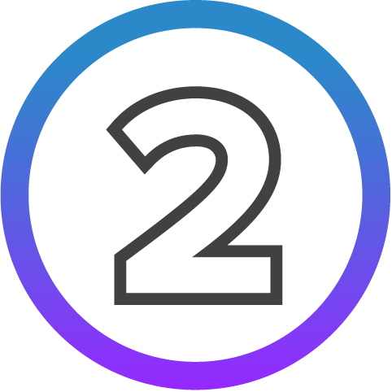
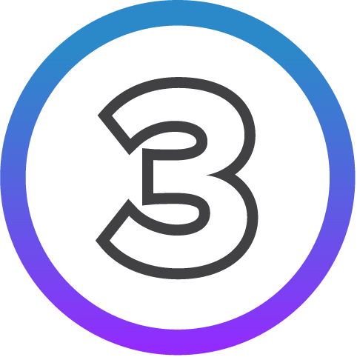

Agenda
Decentralized Identity Concepts
Hyperledger Indy Architecture
Demo Use Case
Hyperledger Indy and How to Get Involved

Slide 26
Hyperledger Indy Architecture

Slide 27
Hyperledger Indy's Open Source Architecture
Identity extensions
Agent
Node
Indy-SDK
Plenum consensus
Crypto
Notes:
Crypto Layer - contains the code necessary to do ZKP, signed state proofs. Working to make this shared.
Plenum/Node - Distributed Ledger that we use.
Plenum - generic ledger implementation
Node - transaction sets that are used for Identity. Creating new identifiers (NIM) transaction. Credential definition transaction. Schema transaction. Does validation that you are only doing what you should.
SDK - Ability to talk to the ledger. Invalidate claims and proofs. Put these things inside of an application to allow it to become identity aware.
Agent - Service that can listen for messages to talk about messages that need to be exchanged.
Identity Solutions - Community is building. Some open source and some that are not.

Slide 28
Hyperledger Indy Crypto
Currently used by Hyperledger Indy for ZKPs and signed state proofs
Includes signature schemes like CL Signatures and BLS signatures
Working to consolidate with Hyperledger-Labs Crypto-lib
Notes:
Crypto Layer - contains the code necessary to do ZKP, signed state proofs. Working to make this shared.
Plenum/Node - Distributed Ledger that we use.
Plenum - generic ledger implementation
Node - transaction sets that are used for Identity. Creating new identifiers (NIM) transaction. Credential definition transaction. Schema transaction. Does validation that you are only doing what you should.
SDK - Ability to talk to the ledger. Invalidate claims and proofs. Put these things inside of an application to allow it to become identity aware.
Agent - Service that can listen for messages to talk about messages that need to be exchanged.
Identity Solutions - Community is building. Some open source and some that are not.

Slide 29
Hyperledger Indy's Plenum Architecture
Identity extensions
Agent
Node
Indy-SDK
Plenum consensus
Crypto
Notes:
Crypto Layer - contains the code necessary to do ZKP, signed state proofs. Working to make this shared.
Plenum/Node - Distributed Ledger that we use.
Plenum - generic ledger implementation
Node - transaction sets that are used for Identity. Creating new identifiers (NIM) transaction. Credential definition transaction. Schema transaction. Does validation that you are only doing what you should.
SDK - Ability to talk to the ledger. Invalidate claims and proofs. Put these things inside of an application to allow it to become identity aware.
Agent - Service that can listen for messages to talk about messages that need to be exchanged.
Identity Solutions - Community is building. Some open source and some that are not.

Slide 30
Hyperledger Indy Plenum
Based on RBFT protocol
Leader based consensus with redundancy checks
Can sustain F failures, where 3F+1 nodes present
E.g. can sustain 4 failures when 13 nodes present, 13 ≥ 3 (4) + 1
Notes:
Crypto Layer - contains the code necessary to do ZKP, signed state proofs. Working to make this shared.
Plenum/Node - Distributed Ledger that we use.
Plenum - generic ledger implementation
Node - transaction sets that are used for Identity. Creating new identifiers (NIM) transaction. Credential definition transaction. Schema transaction. Does validation that you are only doing what you should.
SDK - Ability to talk to the ledger. Invalidate claims and proofs. Put these things inside of an application to allow it to become identity aware.
Agent - Service that can listen for messages to talk about messages that need to be exchanged.
Identity Solutions - Community is building. Some open source and some that are not.

Slide 31
Hyperledger Indy's Node Architecture
Identity extensions
Agent
Node
Indy-SDK
Plenum consensus
Crypto
Notes:
Crypto Layer - contains the code necessary to do ZKP, signed state proofs. Working to make this shared.
Plenum/Node - Distributed Ledger that we use.
Plenum - generic ledger implementation
Node - transaction sets that are used for Identity. Creating new identifiers (NIM) transaction. Credential definition transaction. Schema transaction. Does validation that you are only doing what you should.
SDK - Ability to talk to the ledger. Invalidate claims and proofs. Put these things inside of an application to allow it to become identity aware.
Agent - Service that can listen for messages to talk about messages that need to be exchanged.
Identity Solutions - Community is building. Some open source and some that are not.

Slide 32
Hyperledger Indy Node
Transaction sets that are used for Identity
identifiers (NYM) transaction
Credential definition transactions
Schema transaction
Registration registry transactions
Does validation that you are only doing what you should
Wraps Plenum consensus algorithm
Notes:
Crypto Layer - contains the code necessary to do ZKP, signed state proofs. Working to make this shared.
Plenum/Node - Distributed Ledger that we use.
Plenum - generic ledger implementation
Node - transaction sets that are used for Identity. Creating new identifiers (NIM) transaction. Credential definition transaction. Schema transaction. Does validation that you are only doing what you should.
SDK - Ability to talk to the ledger. Invalidate claims and proofs. Put these things inside of an application to allow it to become identity aware.
Agent - Service that can listen for messages to talk about messages that need to be exchanged.
Identity Solutions - Community is building. Some open source and some that are not.

Slide 33
Hyperledger Indy's SDK Architecture
Identity extensions
Agent
Node
Indy-SDK
Plenum consensus
Crypto
Notes:
Crypto Layer - contains the code necessary to do ZKP, signed state proofs. Working to make this shared.
Plenum/Node - Distributed Ledger that we use.
Plenum - generic ledger implementation
Node - transaction sets that are used for Identity. Creating new identifiers (NIM) transaction. Credential definition transaction. Schema transaction. Does validation that you are only doing what you should.
SDK - Ability to talk to the ledger. Invalidate claims and proofs. Put these things inside of an application to allow it to become identity aware.
Agent - Service that can listen for messages to talk about messages that need to be exchanged.
Identity Solutions - Community is building. Some open source and some that are not.

Slide 34
Hyperledger IndySDK
Assists with interaction of a ledger
Comes with a general purpose storage solution called a wallet with standard interface
Agent to Agent protocol features built in to facilitate peer to peer interactions
Enables rich identity features for developers to use to build agents and agent extensions
Written in rust with c-callable APIs for easy wrapper maintainability
Notes:
Crypto Layer - contains the code necessary to do ZKP, signed state proofs. Working to make this shared.
Plenum/Node - Distributed Ledger that we use.
Plenum - generic ledger implementation
Node - transaction sets that are used for Identity. Creating new identifiers (NIM) transaction. Credential definition transaction. Schema transaction. Does validation that you are only doing what you should.
SDK - Ability to talk to the ledger. Invalidate claims and proofs. Put these things inside of an application to allow it to become identity aware.
Agent - Service that can listen for messages to talk about messages that need to be exchanged.
Identity Solutions - Community is building. Some open source and some that are not.

Slide 35
Hyperledger Indy's Agents Architecture
Identity extensions
Agent
Node
Indy-SDK
Plenum consensus
Crypto
Notes:
Crypto Layer - contains the code necessary to do ZKP, signed state proofs. Working to make this shared.
Plenum/Node - Distributed Ledger that we use.
Plenum - generic ledger implementation
Node - transaction sets that are used for Identity. Creating new identifiers (NIM) transaction. Credential definition transaction. Schema transaction. Does validation that you are only doing what you should.
SDK - Ability to talk to the ledger. Invalidate claims and proofs. Put these things inside of an application to allow it to become identity aware.
Agent - Service that can listen for messages to talk about messages that need to be exchanged.
Identity Solutions - Community is building. Some open source and some that are not.

Slide 36
Hyperledger Indy Agent
Built using functionality from IndySDK
Extensible to different "message families" allowing for applications to build around a strong identity paradigm
Notes:
Crypto Layer - contains the code necessary to do ZKP, signed state proofs. Working to make this shared.
Plenum/Node - Distributed Ledger that we use.
Plenum - generic ledger implementation
Node - transaction sets that are used for Identity. Creating new identifiers (NIM) transaction. Credential definition transaction. Schema transaction. Does validation that you are only doing what you should.
SDK - Ability to talk to the ledger. Invalidate claims and proofs. Put these things inside of an application to allow it to become identity aware.
Agent - Service that can listen for messages to talk about messages that need to be exchanged.
Identity Solutions - Community is building. Some open source and some that are not.

Slide 37
Hyperledger Indy's Identity Solutions
Identity extensions
Agent
Node
Indy-SDK
Plenum consensus
Crypto
Notes:
Crypto Layer - contains the code necessary to do ZKP, signed state proofs. Working to make this shared.
Plenum/Node - Distributed Ledger that we use.
Plenum - generic ledger implementation
Node - transaction sets that are used for Identity. Creating new identifiers (NIM) transaction. Credential definition transaction. Schema transaction. Does validation that you are only doing what you should.
SDK - Ability to talk to the ledger. Invalidate claims and proofs. Put these things inside of an application to allow it to become identity aware.
Agent - Service that can listen for messages to talk about messages that need to be exchanged.
Identity Solutions - Community is building. Some open source and some that are not.

Slide 38
Extending the Indy Agent
Easy way to build Indy into existing applications if an agent already exists on the device
Notes:
Crypto Layer - contains the code necessary to do ZKP, signed state proofs. Working to make this shared.
Plenum/Node - Distributed Ledger that we use.
Plenum - generic ledger implementation
Node - transaction sets that are used for Identity. Creating new identifiers (NIM) transaction. Credential definition transaction. Schema transaction. Does validation that you are only doing what you should.
SDK - Ability to talk to the ledger. Invalidate claims and proofs. Put these things inside of an application to allow it to become identity aware.
Agent - Service that can listen for messages to talk about messages that need to be exchanged.
Identity Solutions - Community is building. Some open source and some that are not.

Slide 39
Connecting the Architecture Pieces
Identity extensions
Agent
Node
Indy-SDK
Plenum consensus
Crypto
Notes:
Crypto Layer - contains the code necessary to do ZKP, signed state proofs. Working to make this shared.
Plenum/Node - Distributed Ledger that we use.
Plenum - generic ledger implementation
Node - transaction sets that are used for Identity. Creating new identifiers (NIM) transaction. Credential definition transaction. Schema transaction. Does validation that you are only doing what you should.
SDK - Ability to talk to the ledger. Invalidate claims and proofs. Put these things inside of an application to allow it to become identity aware.
Agent - Service that can listen for messages to talk about messages that need to be exchanged.
Identity Solutions - Community is building. Some open source and some that are not.

Slide 40


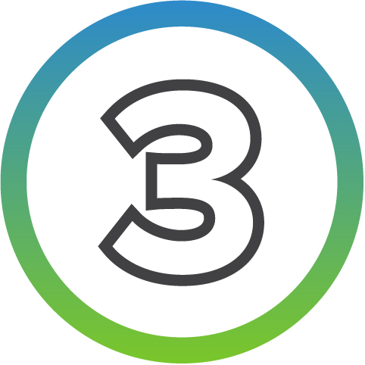

Agenda
The Linux Foundation and Hyperledger
Decentralized Identity Concepts
Demo Use Case
Hyperledger Indy and How to Get Involved

Slide 41


Tools, libraries, and reusable components for providing digital identities rooted on blockchains or other distributed ledgers so that they are interoperable across administrative domains, applications, and any other silo.

Slide 42







Collaboration Tools
Account
Sign up for a Linux Foundation account
Chat
Join the discussion on chat
Mailing Lists
Participate on the Hyperledger Mailing Lists
Github
Check out our code repositories
Wiki
Get the latest development updates from the wiki
Bug Reporting
Search for open bugs, or report a new one, in our bug database

Slide 43

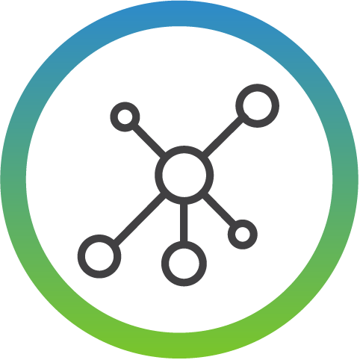


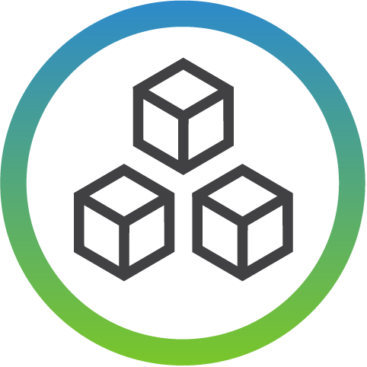


Contribute to Coding
CONTRIBUTING guides
Get a copy of the repository
Find an issue to work on
Make your changes
Create a pull request
Expect comments
Address comments
Notes:
The first step is to explore the CONTRIBUTING guide for the project. These guides will give you information on how to file a bug, what coding standards are followed, where to find the code, where to look for issues that you might start with, requirements for pull requests, and other information that will make you successful in the community.
Next, you will need to get the code on your machine so that you can make your changes. If you are working with a project that uses Gerrit, you will get the clone command from gerrit.hyperledger.com. Choose the `clone with commit-msg hook` and use SSH. If you are working with a project that uses Github, you will first want to fork the repository and then clone your local repository. Look for my upcoming videos that will show you the general workflow for both Gerrit and Github.
Next you need to find an issue that you want to work on. A number of our projects have issues that are labels with a help wanted tag or a good first bug tag. If this is your first time contributing, these issues are always good ones to start with.
Once you have found something that you want to work on, make your changes. Test and verify your changes, before submitting a pull request.
No matter how small the pull request, you should expect comments. Comments are normal. Don't let them scare you away. Instead, address the comments, and re-submit your pull request. It may take a couple of times through this process, but eventually you will have your first merged pull request.

Slide 44
Wiki
Pointers to documentation, source code, and other useful information about Hyperledger Indy
https://wiki.hyperledger.org/projects/indy

Slide 45
General Working Group Call
Development and architecture discussions
Thursday 8 AM PT, 11 AM ET, 5 PM CET
https://zoom.us/j/hyperledger-community

Slide 46
Agents Working Group Call
Indy Agent architecture discussions
Wednesday 12 PM PT, 3 PM ET, 9 PM CET
https://zoom.us/j/856588081

Slide 47
Project Enhancement
RFC process for documenting and proposing changes to the project
https://github.com/hyperledger/indy-hipe

Slide 48
Communication Channels
Chat:
https://chat.hyperledger.org/channel/indy
Mailing List: https://lists.hyperledger.org/g/indy

Slide 49
Agenda
The Linux Foundation and Hyperledger
Decentralized Identity Concepts
Hyperledger
Indy and How
to Get Involved
Demo Use Case

Slide 50
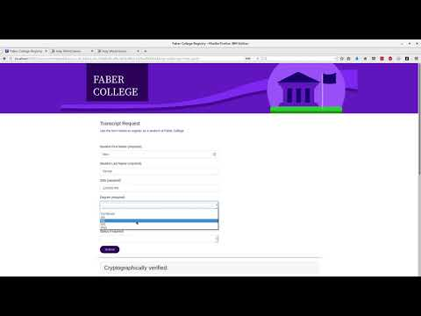
IBM Hyperledger Indy Demo Video

Slide 51
https://github.com/IBM-Blockchain-Identity/indy-ssivc-tutorial
by IBM Identity Team

Slide 52

Questions?
Kyle Den Hartog, Hyperledger Technical Ambassador, Evernym
twitter.com/kyle_dh
@kdenhartog on Hyperledger Chat

Slide 53
https://github.com/swcurran/education/tree/add-indy/LFS171x/indy-material/nodejs
By Stephen Curran
of
British Columbia Provincial Government

Slide 54
https://github.com/kdenhartog/Indy-dev
By Kyle Den Hartog

Slide 55
Extra slides

Slide 56
3rd Dimension: Agents Axis
you
your iPad
a cloud agent
your mobile phone
Agents
your notebook
You have agents that help you do things.
‹#›

Slide 57
The relationship~attribute plane
Relationships
Who knows what about me?
you
Attributes
Agents

Slide 58
Lending Example
Relationships
your employment credential
Acme (employer)
UBS (lender)
you
Attributes
salary
role
name
Agents
Notes:
From Verifiable Credentials Model 1.0
holder
A role an entity may perform by possessing one or more verifiable credentials. Examples of holders include students, employees, and customers.
issuer
A role an entity may perform by creating a verifiable credential, associating it with a particular subject, and transmitting it to a holder. Examples of issuers include corporations, non-profits, trade associations, governments, and individuals.
verifier
A role an entity may perform by receiving one or more verifiable credentials for processing. Examples of verifiers include employers, security personnel, and websites.
identifier registry
A role a system may perform by mediating the creation and verification of subject identifiers. Examples of identifier registries include corporate employee databases, government ID databases, and distributed ledgers.

Slide 59
The relationship~agent plane
Relationships
Which proxy represents me,
in which contexts, and how?
you
Attributes
Agents

Slide 60

Banking Example
Relationships
replicated microledger
microledger
UBS (bank)
for UBS
A
1: KEY(A)
B
2: KEY(B)
you
3: KEY(C)
Attributes
4: KEY(C, msg_prox)
C
5: KEY(B, pay(<=100))
6: KEY(A, pay(>100))
your mobile phone
your notebook
your iPad
Agents
a cloud agent

Slide 61
The Agent~attribute plane
Relationships
you
Attributes
Which proxy can share what about me?
Agents

Slide 62
Lost Phone Example
Relationships
you
your mobile phone: W
Attributes
your notebook: X
your iPad: Y
a cloud agent: Z
1: ADD( [W, X, Y], [PROVE] )
2: POLICY( 2 of [W, X, Y], [GRANT] )
3: ADD( [Z], [] )
Agents
4: POLICY( 2 of [W, X, Y, Z], [REVOKE] )
5: REVOKE( W, [σ-X, σ-Y] )

